Slide 1
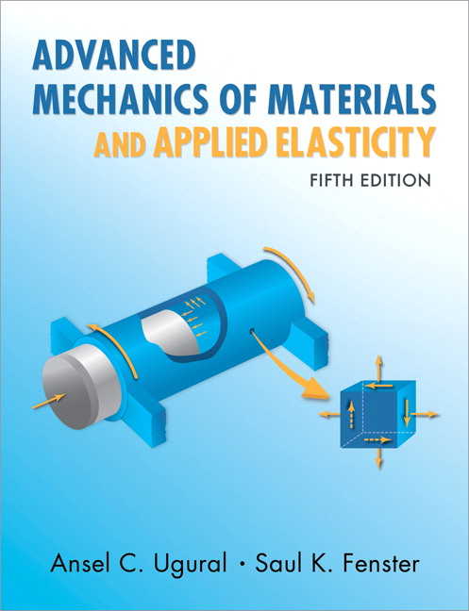
Advanced Mechanics
(Lecture 25)
ANNOUNCE / BUSINESS
HW 13 (due H, 4/17)
PREVIOUS
Castigliano’s method
TODAY
Buckling

Slide 2


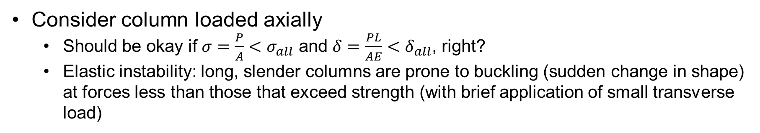
Column Buckling
Consider column loaded axially
Should be okay if $σ=\frac{P}{A}<σ_{all}$ and $δ=\frac{PL}{AE}<δ_{all}$, right?
Elastic instability: long, slender columns are prone to buckling (sudden change in shape) at forces less than those that exceed strength (with brief application of small transverse load)

Slide 3
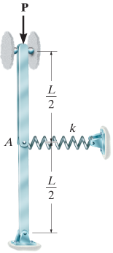
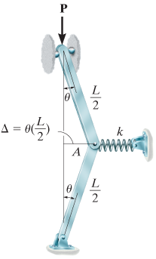
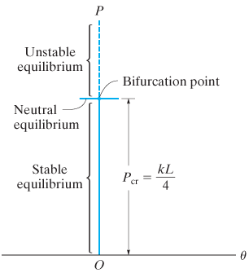
Critical Load
Can we quantify the critical load? What factors matter? Consider a model:

Slide 4
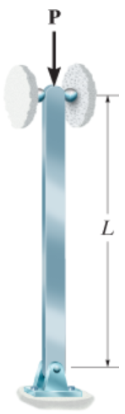
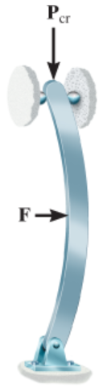
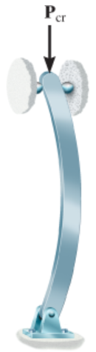
Ideal Column with Pin Supports

Slide 5
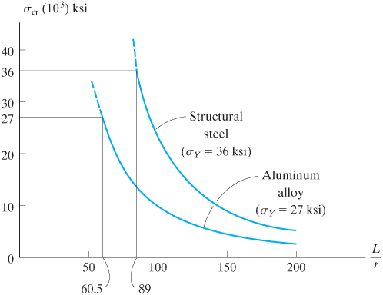
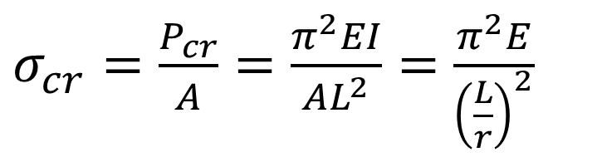
Design Considerations
Maximize $P_{cr}$, where $P_{cr}=\frac{π^{2}EI}{L^{2}}$
For selected material and length, maximize $I$
Can also think of in terms of stress and slenderness ratio ($L/r$)
Note that Euler’s formula only works if $σ_{cr}<σ_{Y},σ_{U}$
$σ_{cr}=\frac{P_{cr}}{A}=\frac{π^{2}EI}{AL^{2}}=$ $\frac{π^{2}E}{{\left(\frac{L}{r}\right)}^{2}}$

Slide 6
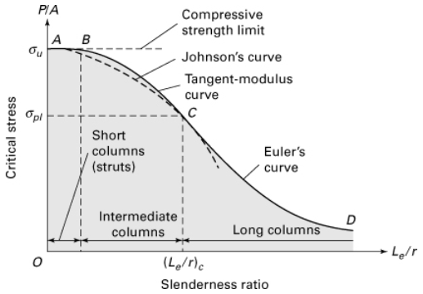

Classification of Columns
By slenderness ratio …
Transition points depend on material properties, geometry
(no instability)
$$σ_{yp}$$

Slide 7
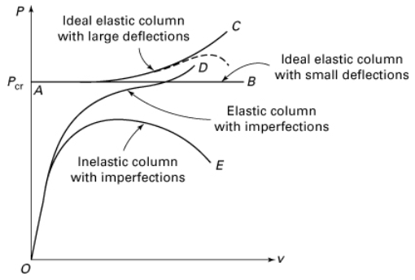
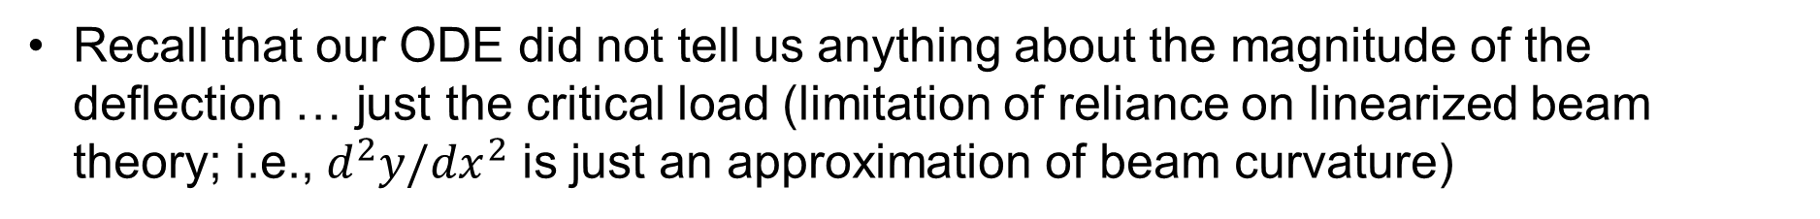
Deflection Response
Recall that our ODE did not tell us anything about the magnitude of the deflection … just the critical load (limitation of reliance on linearized beam theory; i.e., $d^{2}y/{dx}^{2}$ is just an approximation of beam curvature)
Variables
large deflections
imperfections (misalignment, crookedness)
inelasticity

Slide 8
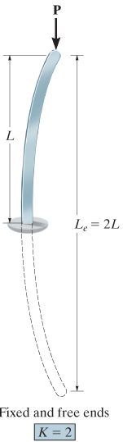
Other Support Conditions

Slide 9

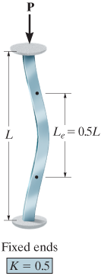
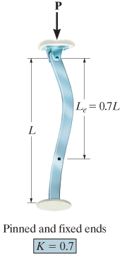
Other Support Conditions
Effective length $L_{e}$
Distance between points of zero moment
$$P_{cr}=\frac{π^{2}EI}{{(KL)}^{2}}=\frac{π^{2}EI}{L_{e}^{2}}$$

Slide 10
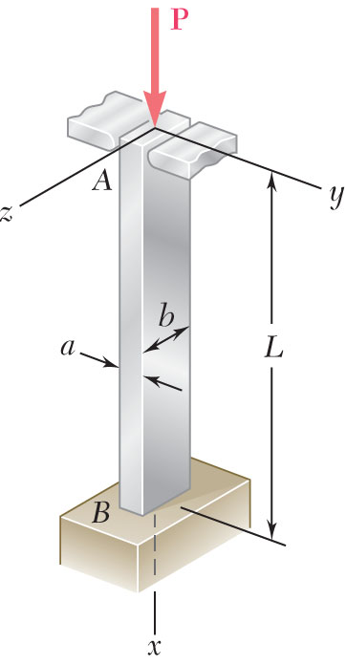
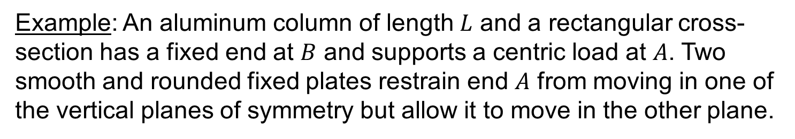
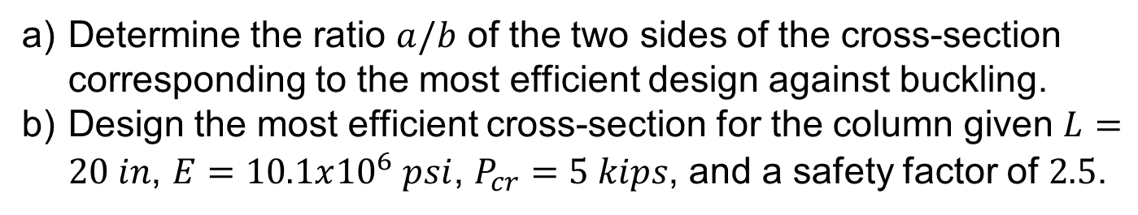
Example: An aluminum column of length $L$ and a rectangular cross-section has a fixed end at $B$ and supports a centric load at $A$. Two smooth and rounded fixed plates restrain end $A$ from moving in one of the vertical planes of symmetry but allow it to move in the other plane.
Determine the ratio $a/b$ of the two sides of the cross-section corresponding to the most efficient design against buckling.
Design the most efficient cross-section for the column given $L=20 in$, $E=10.1x{10}^{6} psi$, $P_{cr}=5 kips$, and a safety factor of $2.5$.

Slide 11
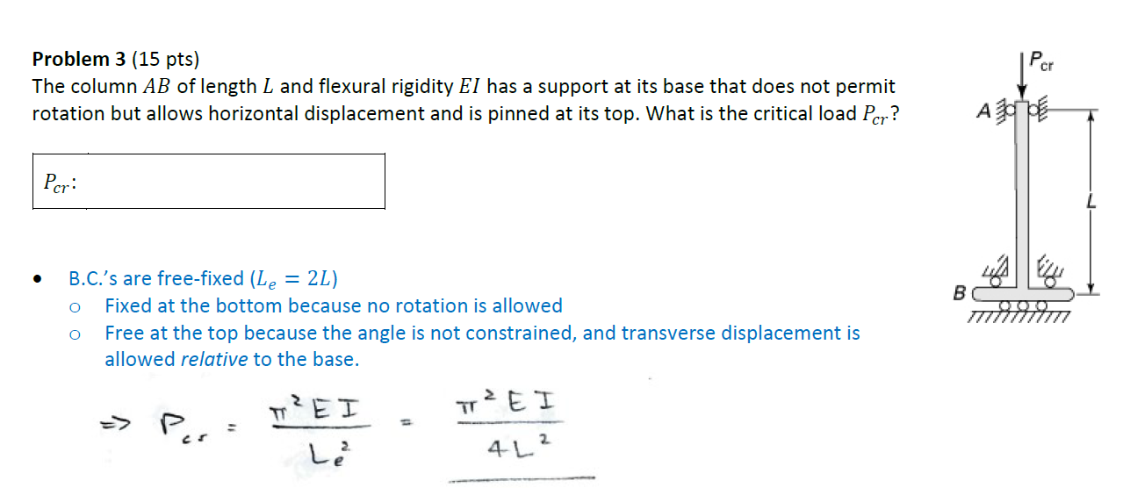
Discuss this problem from 2024 final exam …

Slide 12
Discuss this problem from 2024 final exam …

